Slide 1
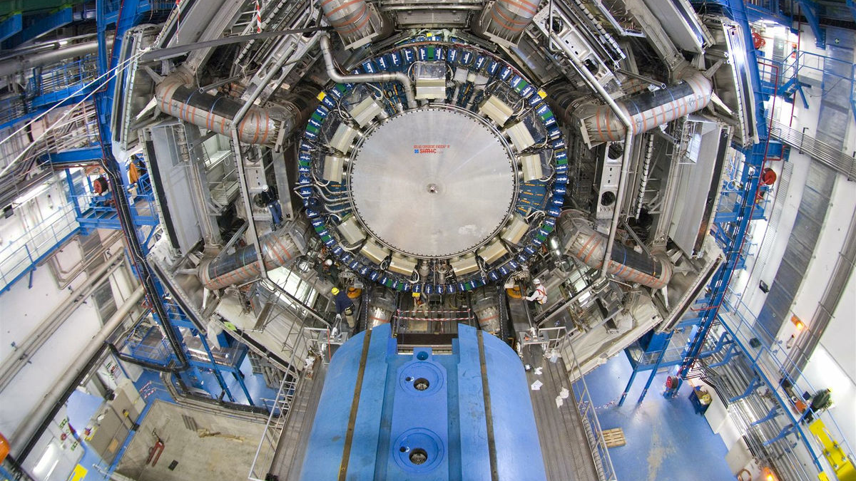


CIS Techs Update
Tile Week, June 15th, 2023
Jacky Li and Peter Camporeale

Slide 2
Yes, we are “updating” ourselves…
Every year, University of Chicago sends two people for a rotation as CIS techs, and our time is almost up…
This is our last tile week presentation, we briefly summarize the past year:
CIS Constant Updates
Regular Calibration
Year-End Reprocessing and Public Plots
TUCS updates
Maintenance
L1Calo
Monitoring
Radiation
DCS
Irradiation tests at PSI
Shifts
Reports
Wiki/Documentation Updates

Slide 3
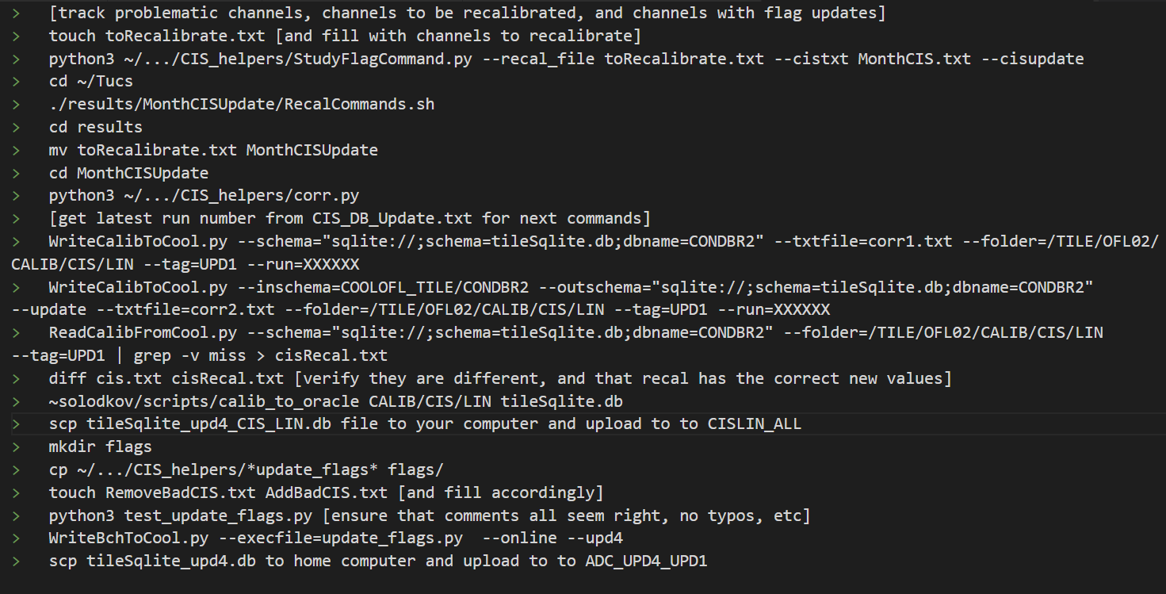
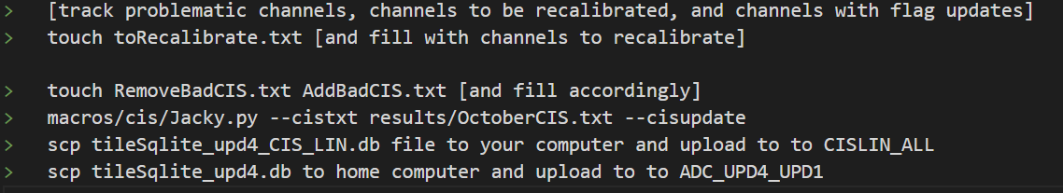
TUCS Update
As the main software code that handles the CIS calibration, the CIS techs carefully reviewed the TUCS codes and made improvements to it.
Old code recovery from Python 2 to Python 3
Edge case bug fixes
A more automatic process - no more outside code, all integrated & simpler!
Separation of process with demonstrator(LBA14) and legacy
Multi-IOV fixes for reprocessing
Now, the time-consuming part only lies in determining Channels to recalibrate. This helps free up CIS techs’ time to help with other Tile related tasks.
We are pushing these changes to the official Tile git folder for future users!
CIS calibration After
CIS calibration Before

Slide 4
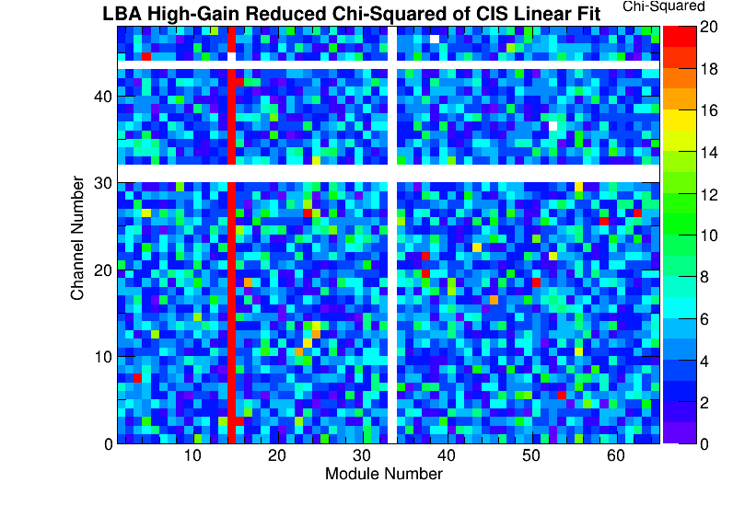
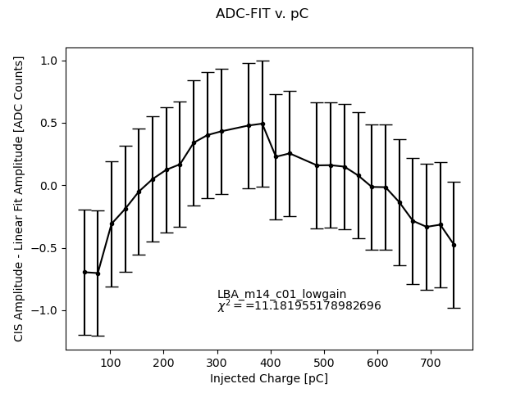
CIS Fitting Issues
LBA14 pulse shape is different due to different electronics
Previous CIS calibrations have been using the default pulse shape, reducing the quality of fit
We’ve developed some tools for understanding the fit quality of pC v. ADC counts (added a new worker to Tucs Chi2Heatmap.py)
As a temporary fix to Tucs, we’ve made some Python scripts to plot ADC v. pC and data-fit
Conclusion: While the fit quality is worse, the actual CIS constant does not change significantly. It would require changes to the CIS run reconstruction in Athena to use a different pulse shape
A talk on this subject: here

Slide 5
Reports given in ATLAS
During the past year, we have presented our work in many ‘Weeks’ in ATLAS:
Tile Week (Oct. 6, 2023) on CIS
Tilecal Calibration, Data Preparation and Performance in Tile Week (2022.10.6.) · Indico (cern.ch)
Tile Week (Feb. 8/9, 2023) on CIS, L1Calo, and Maintenance
TileCal Hardware & Operation Session (2023.2.8.) · Indico (cern.ch)
Tilecal Calibration, Data Preparation and Performance in Tile Week (2023.2.9.) · Indico (cern.ch)
ATLAS Week (Feb. 13, 2023) poster session on CIS and L1Calo
ATLAS Week (Feb 13-17) poster, ATLAS Tile Calorimeter Charge Injection System (CIS) and L1Calo - CERN Document Server
Tile Week (June. 15,2023) on CIS
Tilecal Calibration, Data Preparation and Performance in Tile Week (2023年6月15日) · Indico (cern.ch)
And there were lots of other presentations: CIS updates, public plots, end-of-year reprocessing of CIS constants, L1Calo workshop…

Slide 6
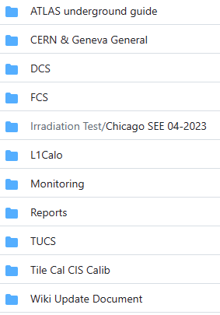
Documentation/Twiki Update
Currently, we keep our records and documentations in https://github.com/JackyMYL/Tile-CIS-group.
Some descriptive documents are uploaded to Twiki, other things like each month’s CIS calibration data/plots, and other codes, are stored here.
Uchicago TWiki:
http://twiki.mwt2.org/UCatCERN/WebHome
(Contains everything UChi related, e.g. the training files for new CIS Techs)
CERN TWiki:
https://twiki.cern.ch/twiki/bin/view/Atlas/TileCal

Slide 7
Reflections and Prospects…
Some Reflections …
There’s a huge breadth of information at CERN. Asking the right people can help orient you amidst the chaos and save some time! We’re tying to make it a bit easier for our successors
The TileCal team is very nice! Experts are willing to share their time and appreciate questions
There are lots of ways to get involved in operations and technical work
What’s next for us?
Jacky will go to Princeton for his Ph.D. in Electrical Engineering
Peter will go to Technische Universität München for his Master’s in Mathematical Physics
Officially, we will leave on July 31 and be replaced by Vivek Sasse and Kyle Lleras.
Chicago is also having a new tile postdoc Yoav Afik.

Slide 8
Thank you for your attention ☺

